Slide 1
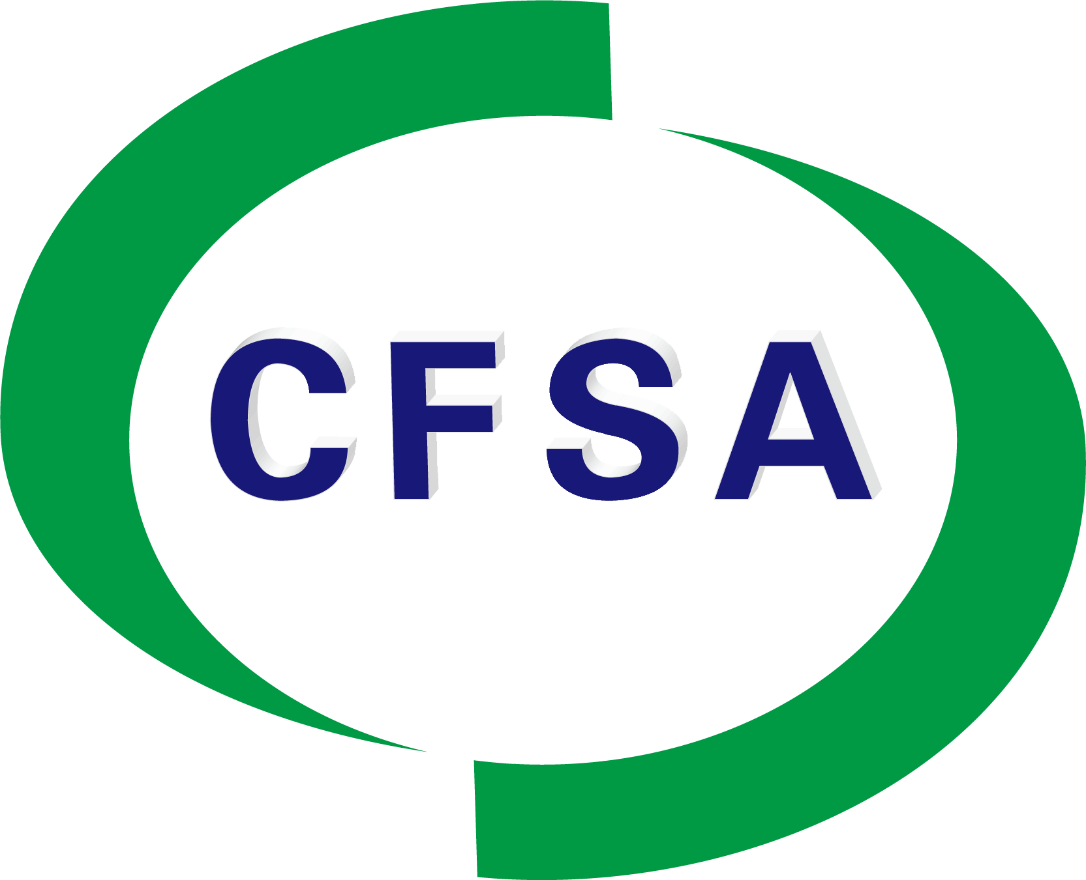
Building a Safer Future: China's Food Safety System and Global Impact
Fan Yongxiang, Deputy Director-General
China National Center for Food Safety Risk Assessment (CFSA)
Chair of Codex Committee on Food Additives(CCFA)

Slide 2
The Importance of Food Safety
Food safety in China
CFSA's Role in Chinese Food Safety System
CFSA's Role Globally
Future Outlook

Slide 3
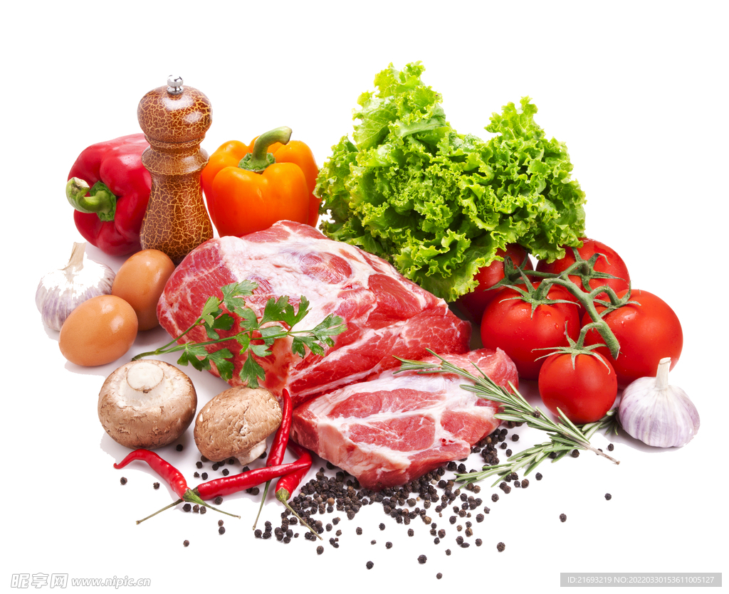
The Importance of Food Safety
Public Health
Economic Growth
Global Cooperation
Ensuring food safety is essential for protecting consumers from foodborne illnesses, which can have severe public health consequences.
A strong food safety system supports the economy by enabling international trade, securing market access, and fostering consumer confidence in domestic products.
Globalization requires standardized food safety regulations to facilitate international trade and ensure the safety of food products across borders.
Notes:
"Food safety is very important all over the world. It plays a key role in three major areas:
Public Health: Ensuring food safety is essential to protect consumers from foodborne illnesses, which can have severe public health consequences. Unsafe food can cause widespread health issues, impacting individuals and communities alike.
Economic Growth: A strong food safety system supports the economy by enabling international trade, securing market access, and fostering consumer confidence in domestic products. It directly contributes to the stability and growth of the economy.
Global Cooperation: Globalization requires standardized food safety regulations to facilitate international trade and ensure the safety of food products across borders. International cooperation in food safety helps prevent risks and ensures food security worldwide.
In conclusion, food safety is critical not just for public health but also for economic development and global collaboration."

Slide 4
The Importance of Food Safety
China’s Vision: To strengthen domestic food safety systems, ensuring healthier and more sustainable trade practices.
China’s Role in Global Trade: As a major food exporter, China faces unique challenges in ensuring food safety. Strengthening its food safety system is critical for global trade and to maintain the trust of both domestic and international consumers.
Notes:
Continuing from the global perspective on food safety, let's take a closer look at China’s commitment.
First, China’s Vision: The country is focused on strengthening its domestic food safety systems, with the goal of ensuring healthier food and more sustainable trade practices. This vision is about building a long-term, safer food environment for both the Chinese population and international consumers.
Second, China’s Role in Global Trade: As one of the world’s largest food exporters, China faces specific challenges when it comes to food safety. To maintain the trust of global markets and ensure the safety of its products, it’s crucial for China to continually improve its food safety systems. This commitment not only secures domestic consumer health but also plays a key role in the global food trade.
In short, China is working hard to improve its food safety practices both for the well-being of its people and as a responsible player in international food trade.

Slide 5
Food Safety in China
China’s Food Safety System: Key Upgrade
Food Safety Law: The enactment of the Food Safety Law established a unified system for food safety regulation, emphasizing traceability, testing, and consumer protection.
China National Center for Food Safety Risk Assessment (CFSA): The CFSA conducts food safety risk assessments and provides scientific evidence to support national food safety standards and regulatory policies. These efforts aim to ensure a safer food supply chain for both consumers and international trade partners.
Notes:
China has made significant upgrades to its food safety system, starting with the Food Safety Law, which established a unified and comprehensive framework for regulating food safety. This law emphasizes key aspects such as traceability, rigorous testing, and consumer protection, ensuring that every stage of the food supply chain meets safety standards.
In addition to the Food Safety Law, the China National Center for Food Safety Risk Assessment (CFSA) plays a critical role in the country's food safety efforts. The CFSA conducts in-depth food safety risk assessments and provides scientific evidence to support national food safety standards and regulatory policies. These efforts are crucial for ensuring a safer food supply chain, benefiting both consumers within China and international trade partners."

Slide 6
Food Safety in China
Food Safety Regulatory Framework in China
Farm
Table
Ministry of Agriculture and Rural Affairs (MARA)
Establishes agricultural product standards and oversees safety at the agricultural production level.
National Health Commission(NHC)
Conducts risk assessments and sets national food safety standards.
State Administration for Market Regulation (SAMR)
General Administration of Customs of China(GACC)
Ensures food safety enforcement and compliance across the food supply chain, from production to retail.
Ensures food safety enforcement import and export.
Provides technical support
Notes:
China’s food safety system is a multi-level structure, with different government agencies overseeing various stages of the food supply chain, from farm to table.
the Ministry of Agriculture and Rural Affairs (MOA) is responsible for establishing agricultural product standards and ensuring safety at the agricultural production level. The MOA formulates safety standards for agricultural products, regulates production practices, and manages risks associated with farming.
State Administration for Market Regulation (SAMR) ensures the enforcement and compliance of food safety laws across the food supply chain, from production to retail. SAMR oversees regulatory inspection and ensures that food safety standards are adhered to, protecting consumers from unsafe food products
CFSA provides scientific risk assessments to formulate national food safety standards. It operates under the National Health Commission (NHC) and plays a key role in addressing public health concerns related to food safety.CFSA also provide the technical support to all the MOA, SAMR and NHC.

Slide 7
CFSA’s Role in Chinese Food Safety System
CFSA was established in 2012 in response to China’s growing need for scientific risk assessments in food safety.
Created under the National Health Commission (formerly the Ministry of Health), CFSA’s mission is to enhance China’s food safety system through evidence-based research and risk assessments.
CFSA is the first and only national-level dedicated center in China focused on conducting scientific risk assessments for food safety, playing a critical role in strengthening the food safety system.
Notes:
CFSA was established in 2012 in response to China’s growing need for scientific risk assessments in food safety. With an increasing demand for evidence-based decisions in food safety, CFSA plays a pivotal role in providing the scientific foundation for food safety regulations and policies.
Created under the National Health Commission, CFSA's mission is to enhance China’s food safety system by conducting in-depth research and risk assessments. By using scientific methods and data, CFSA supports the creation of national food safety standards and helps guide regulatory decisions.
As the first and only national-level dedicated center in China focused on food safety risk assessments, CFSA is instrumental in strengthening the overall food safety framework, ensuring that the country’s food supply is both safe and reliable.

Slide 8
Proactive monitor
Passive monitor
Core
responsibilities
Risk surveillance
Risk Assessment
Risk Communication
Standard Management
Pre-Market
Approval
Novel food, New food additives & Packaging
Evaluate potential hazards
Develop Chinese food safety standards
Share information with
the public, stakeholders and policymakers
Notes:
Our core responsibilities include：
Risk surveillance: Both proactive monitoring and passive monitoring were included to ensures timely detection and effective management of food safety risks throughout the supply chain.
Risk assessment involves evaluating potential hazards in the food supply chain helps prioritize actions, set safety standards, and guide decision-making to minimize food safety risks effectively.
Risk communication : sharing information about food safety risks with the public, stakeholders, and policymakers, ensures transparent, accurate, and timely communication to help people understand risks and take appropriate actions to protect their health.
Standard management : including integration of existing standards, the revision of outdated ones, and the development of new standards, ensures a consistent, up-to-date framework for food safety regulations and practices across the entire food supply chain.
Applied nutrition: Managing national food safety standards for foods for special dietary uses, including nutrition labeling, formula foods for specific populations, and the use of nutrition fortifiers. Promote the implementation of the National Nutrition Plan.

Slide 9
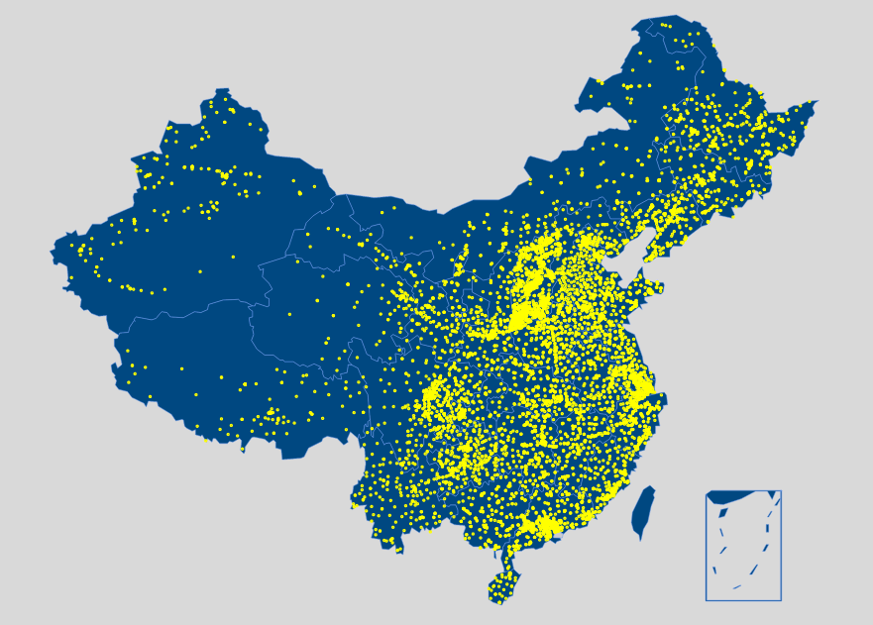
Risk Surveillance System
5 surveillance network around the whole country
Both Chemical and Microbiological contaminants in foods were included.
Foodborne Diseases surveillance system were developed to collect data on foodborne disease outbreaks, clinical cases.
A traceability network of foodborne diseases was built based on Bioinformatics techniques.
Over 1600 indicators, 30 million data; covering 70,000 health facilities, 3,000 CDCs.
Notes:
We have provided significant technical support for China’s food safety efforts, including the risk assessment of contaminants in foods, such as microbiological and chemical contaminants. We have also conducted risk assessments for food allergens. Additionally, in recent years, we have dedicated considerable efforts to the field of nutrition.
The basis of risk assessment is data collection. Therefore, CFSA has developed five key risk surveillance systems, including two databases focused on chemical and microbiological contaminants in food.
In parallel, foodborne diseases have been given equal attention. We have established three systems to collect data on foodborne disease outbreaks, clinical cases, and to use bioinformatics techniques for building a traceability network.
These systems encompass 70,000 health facilities and 3,000 Centers for Disease Control (CDCs), collecting more than 30 million data points.

Slide 10
China TDS Food Categories
Total Diet Study
1.中国总膳食研究
Total Diet Study, TDS: A method to study and estimate the intake of various dietary chemical components (contaminants, nutrients) by a population through representative diets (including drinking water) in cooked/processed, ready-to-eat forms. It is the most cost-effective method for dietary exposure assessment.
Cereals and products
Legumes and products
Tubers and products
Meat and products;
Eggs and products;
Aquatic products and products;
Milk and products;
Vegetables and products
Fruits and products
Sugars
Beverages and Water
Alcoholic beverages
Condiments and Cooking Oils

Slide 11
Study on dietary exposures and health risks
The Sixth China TDS was completed to obtain the dietary exposure results of POPs, mycotoxins, veterinary drugs, pesticides, harmful elements and other contaminants from processing
Study on exposure pathways, body burden and dietary exposure assessment and their health risks of typical persistent organic pollutants (POPs)
1
2
Study on food chemical hazard factors and their metabolites, and building a high-resolution mass spectrometric screening database
3
Study on the correlation between mycotoxin exposure and health effects based on accurate detection method and identification method for unknown or masked mycotoxins
4
Develop food matrix reference materials, and carry out international comparison and capability verification
A
C
B
5

Slide 12
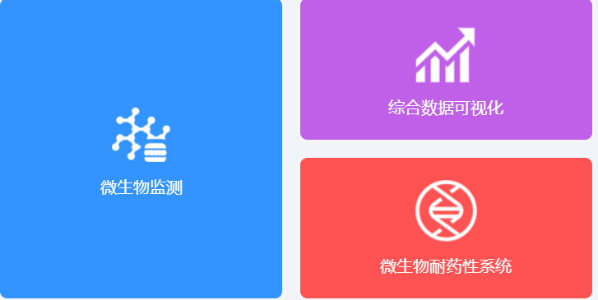
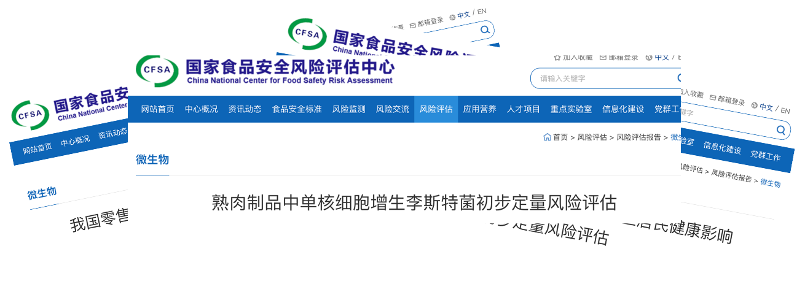
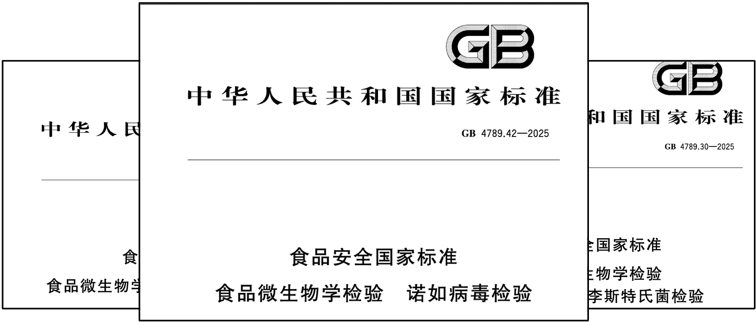
Microbiological Risk Control
Data collection( Microbiological contaminats surveillance system)
Viruses, Bacteria, and Fungi have been included as targets for monitoring, along with antimicrobial resistance.
Risk assessment
National risk assessment reports about important foodborne pathogens (more than 20 items ) were published。.
Standard published
National standard of “Limits of Pathogenic Microorganisms in Prepackaged Foods”, and “General Hygiene Practices for Food Production” were published.
Notes:
For the Microbilogical contaminants, CFSA has developed a comprehensive microbiological contaminants surveillance system, which includes the monitoring of viruses, bacteria, and fungi as key targets. Along with these pathogens, antimicrobial resistance has also been included as a focus area. This system allows for thorough surveillance of microbial contamination across the food supply chain, ensuring that potential health risks are identified and addressed promptly.
National risk assessment reports have been published to evaluate the prevalence of important foodborne pathogens. Over 20 key pathogens have been assessed to determine their impact on food safety, and these reports provide valuable insights into the risk levels and necessary interventions.
Additionally, the GB 4789 series food safety standards have been revised and published. These standards are essential for maintaining the safety and quality of food products, and they serve as a critical guide for food safety practices in China.

Slide 13
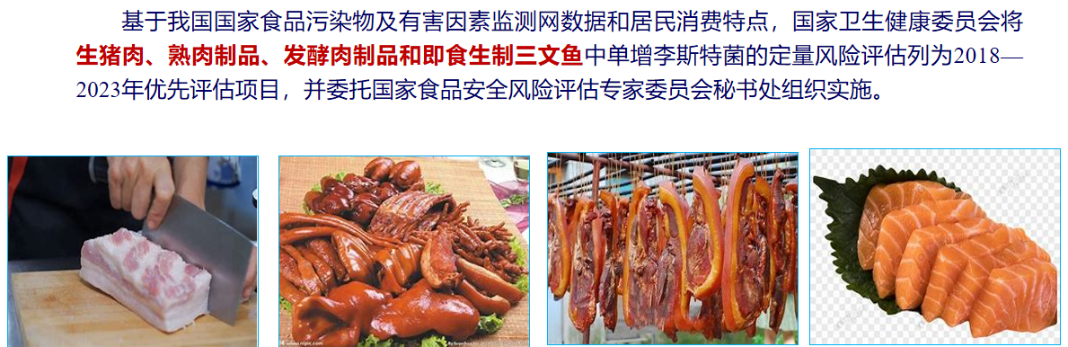
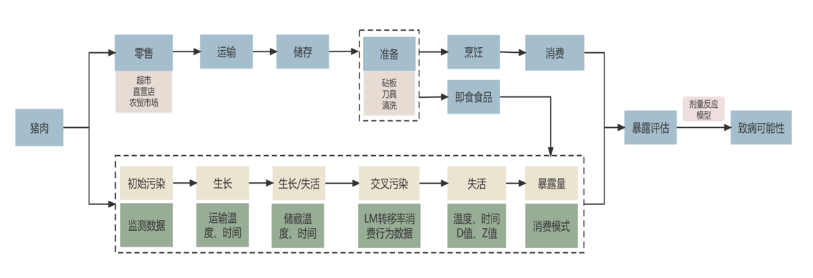
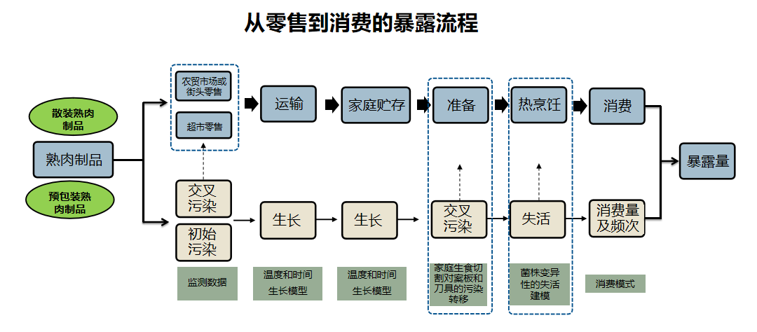
Microbiological Risk Control
-Quantitative risk assessment of Listeria monocytogenes
Conducted the quantitative risk assessment of Listeria monocytogenes in fresh pork, cooked meat products, fermented meat products, and ready-to-eat/raw salmon.
Developed Risk assessment Model: the transmission model of Listeria from retail market to consumers.
Notes:
According to the results of food contaminant and harmful factor monitoring network, The contamination level of Listeria in fresh pork, cooked meat products, fermented meat products, and ready-to-eat/raw salmon were significantly higher than other foods, NHC required the quantitative risk assessment of Listeria
Different model of Listeria from retail market to consumers were developed. the left picture showed the model of raw pork and the right one showed the ready-to-eat food

Slide 14
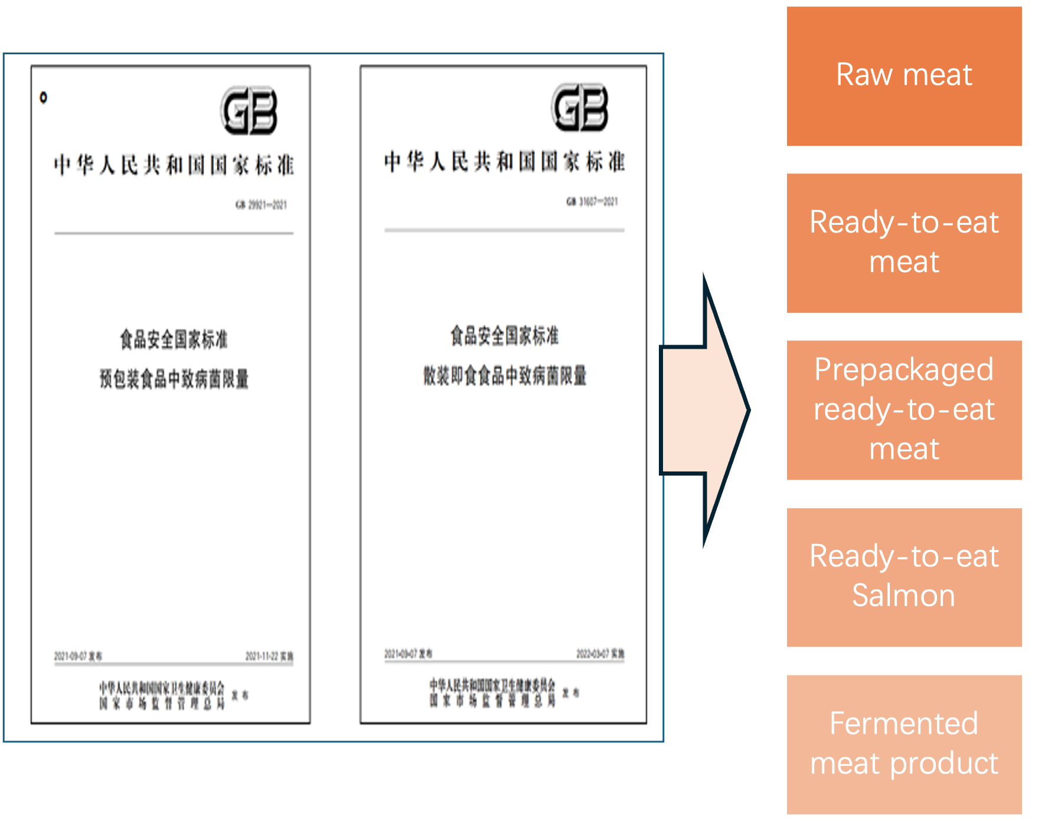
Microbiological Risk Control
-Quantitative risk assessment of Listeria monocytogenes
Risk assessment
The contaminated data of the foods, along with the consumption data and the exposure model we developed, were used to conduct a risk assessment. A risk assessment report was then generated.
Recommendations and Food safety standard
Based on the risk assessment results, recommendations were provided for the government, retail sellers, and consumers.
There is still a lack of a unified national standard for the limits of Listeria monocytogenes in raw and fermented meat in the publicly available data.
Notes:
The contaminated data of the foods, along with the consumption data and the exposure model we developed, were used to conduct a risk assessment. A risk assessment report was then generated.
Based on the risk assessment results, recommendations were provided for the government, retail sellers, and consumers.
Currently, the existing national standards for pathogen limits in China (such as Limits of Pathogenic Microorganisms in Prepackaged Foods and “Limits of Pathogenic Microorganisms in Loose Ready-to-Eat Foods) primarily apply to prepackaged foods and loose ready-to-eat foods. These standards do not cover the limits for Listeria monocytogenes in raw meat and fermented meat products. In other words, there is still a lack of a unified national standard for the limits of Listeria monocytogenes in raw and fermented meat in the publicly available data.

Slide 15
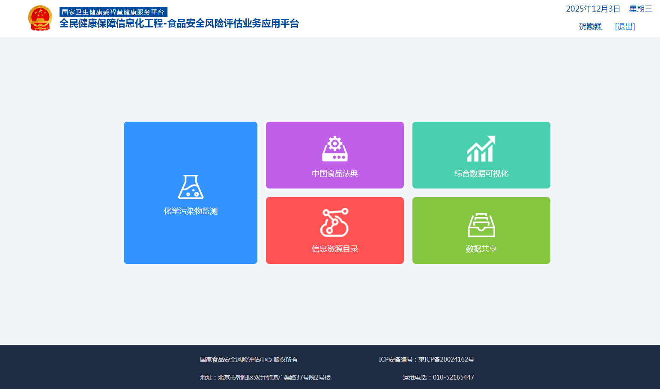
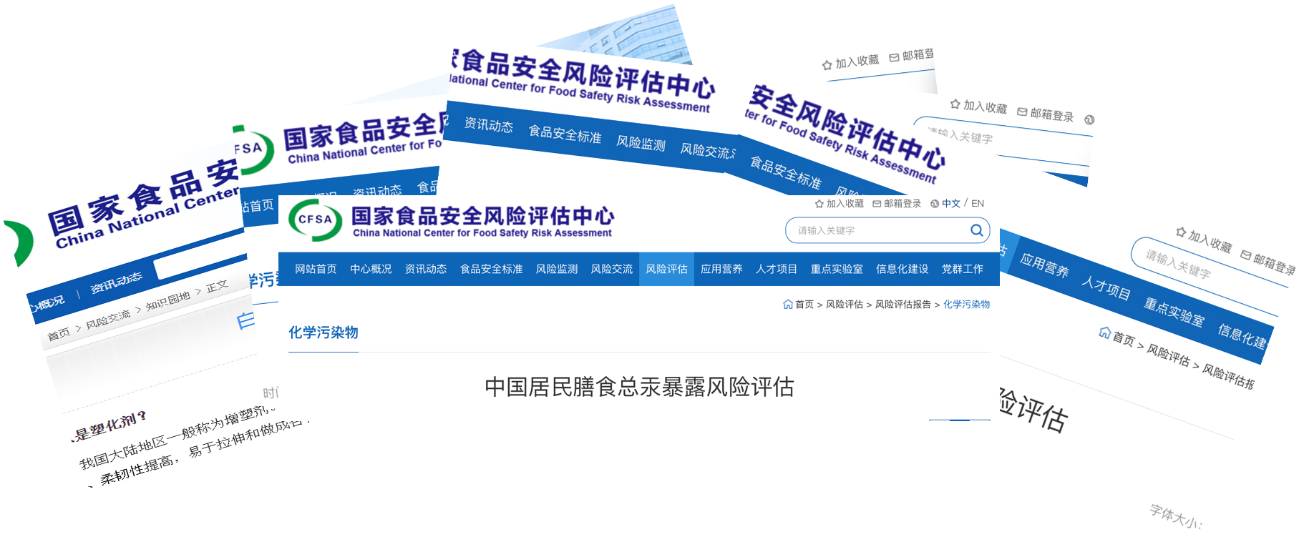
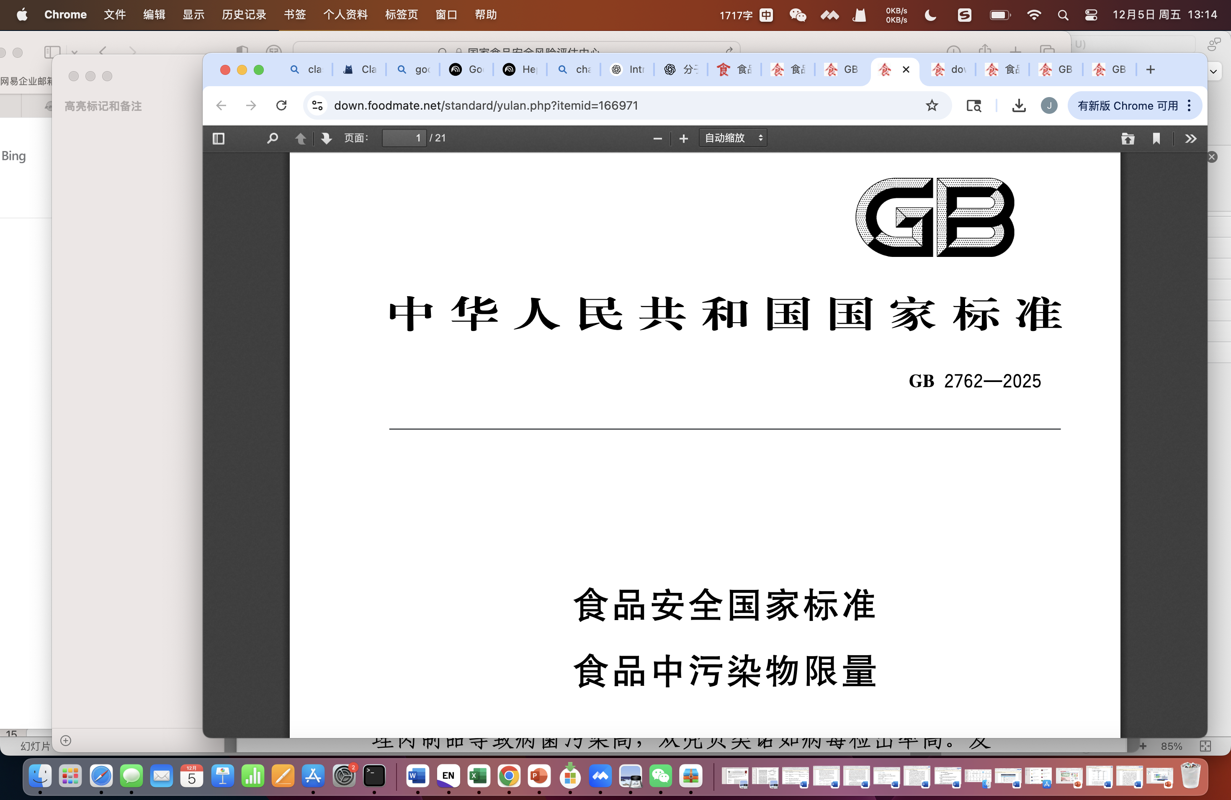
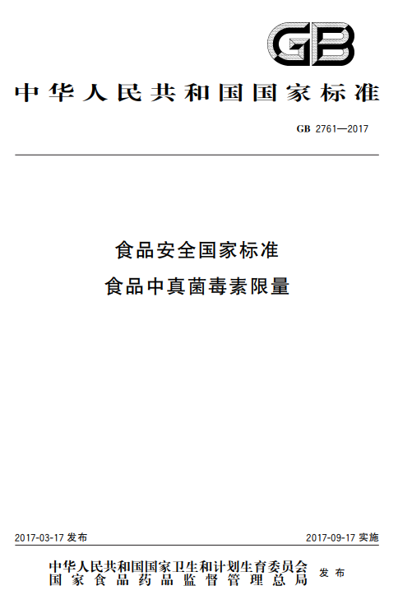
Chemical Risk Control
Data collection( Chemical contaminats surveillance system)
Data of Environmental pollutants, Processing by-products, Biotoxins and Food additives were collected.
Risk assessment
119 risk assessment reports were published. Including Cadmium in rice and complementary foods, dehydroacetic acid in food additives, fumonisins in grains, rare-earth elements in tea, and others.
Related Standards
GB2761 National Food Safety Standard Maximum Levels for Mycotoxins in Foods
GB2762 National Food Safety Standard Maximum Levels for Contaminants in Foods
Notes:
When talk about Chemical contaminants. To ensure comprehensive surveillance, we have developed a chemical contaminants surveillance system. This system collects data on various contaminants, including environmental pollutants, processing by-products, biotoxins, and food additives. By collecting this data, we can identify potential risks and address them in a timely manner.
We have published 119 risk assessment reports on various chemical contaminants in foods. These reports cover a wide range of issues, such as cadmium in rice and complementary foods, dehydroacetic acid in food additives, fumonisins in grains, rare-earth elements in tea, and many other important contaminants. These risk assessments help us understand the scope and impact of these chemicals on food safety.
In addition, the GB 2762-2025 Food Safety National Standard was published. This standard sets the maximum limits of contaminants in food, providing clear guidelines for food safety regulation and compliance.

Slide 16
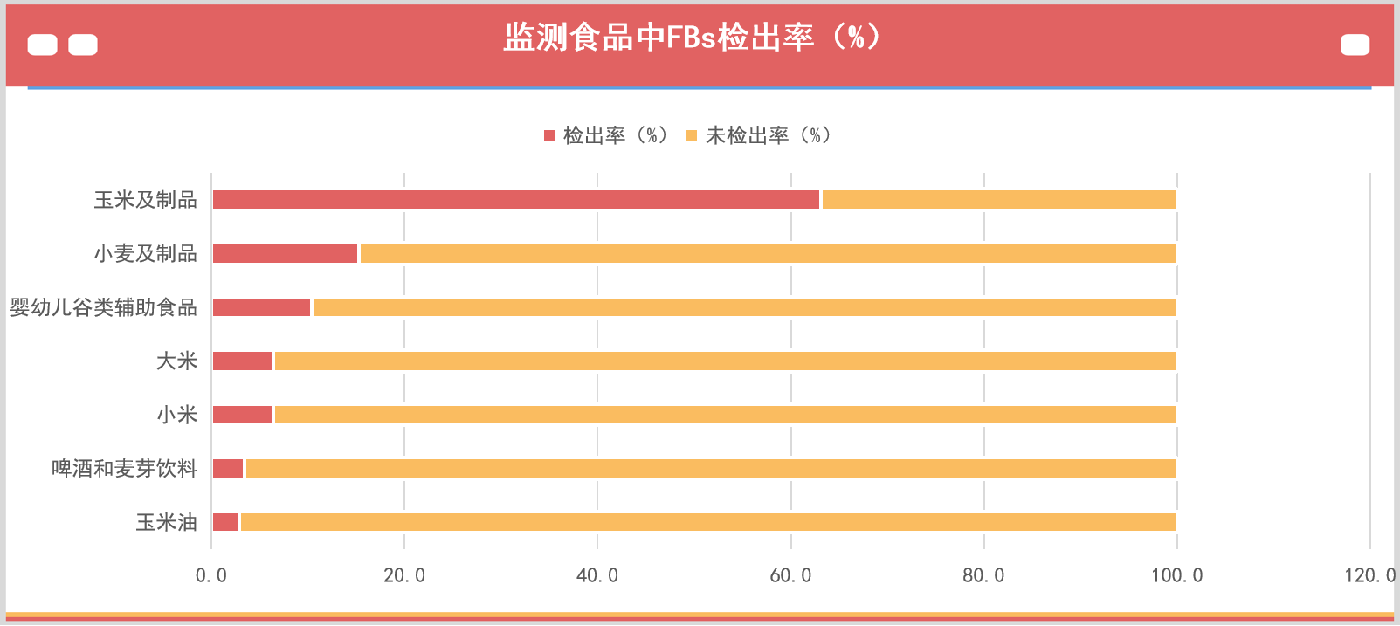
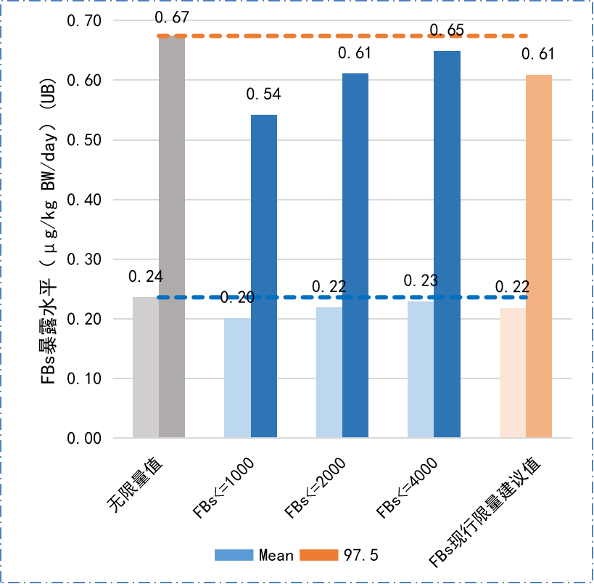
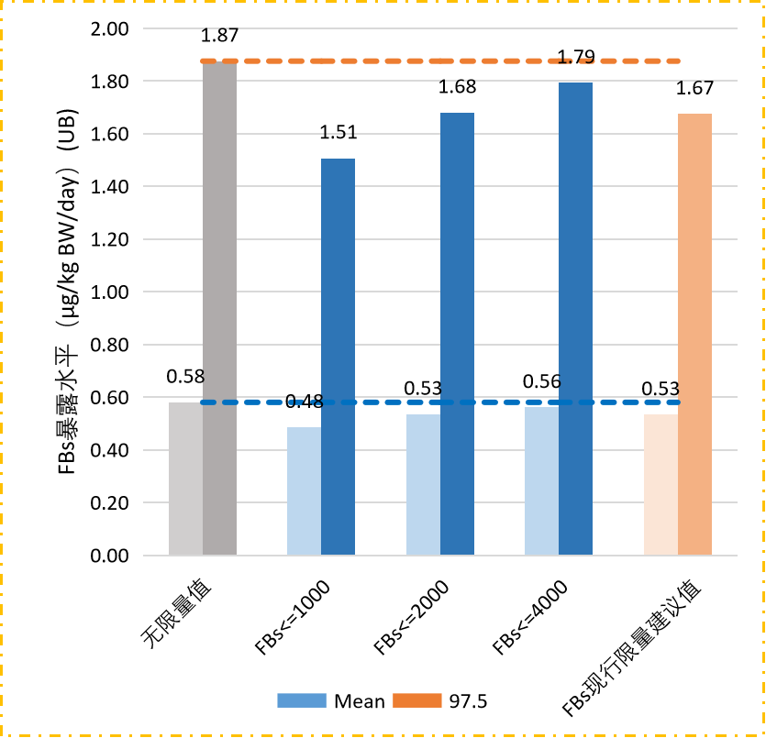
1.中国总膳食研究
Risk Assessment of Dietary Fumonisin Exposure in Chinese Residents
Contamination status of FBs in various monitored food categories
Impact of different proposed MLs on FBs exposure levels in corn-consuming populations
Comprehensively understood the contamination levels of fumonisins in major food categories in China
Systematically assessed the health risks of fumonisin exposure from major dietary sources for Chinese residents.The health risk from dietary FBs exposure for the entire population is relatively low. Rice and wheat products are the main food sources of FBs exposure for the entire population, accounting for about 80% of total exposure. Corn and its products account for 15~26%.
Promoted the establishment of MLs for fumonisins in corn and its products (Standard setting).

Slide 17
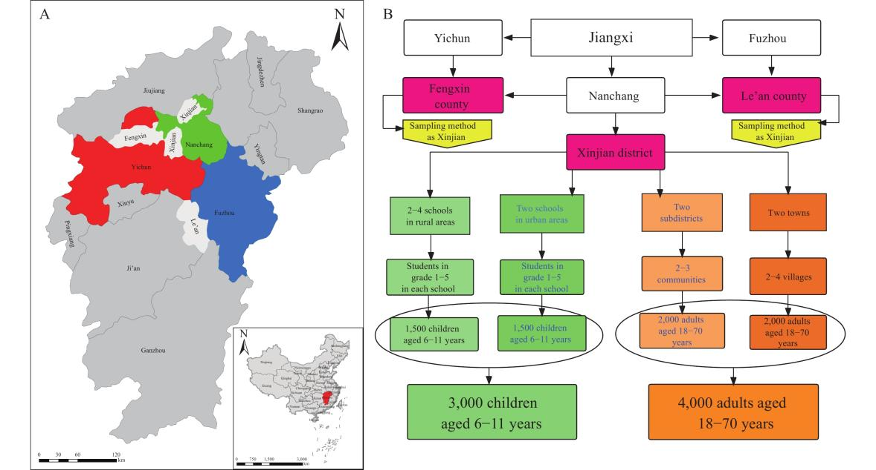
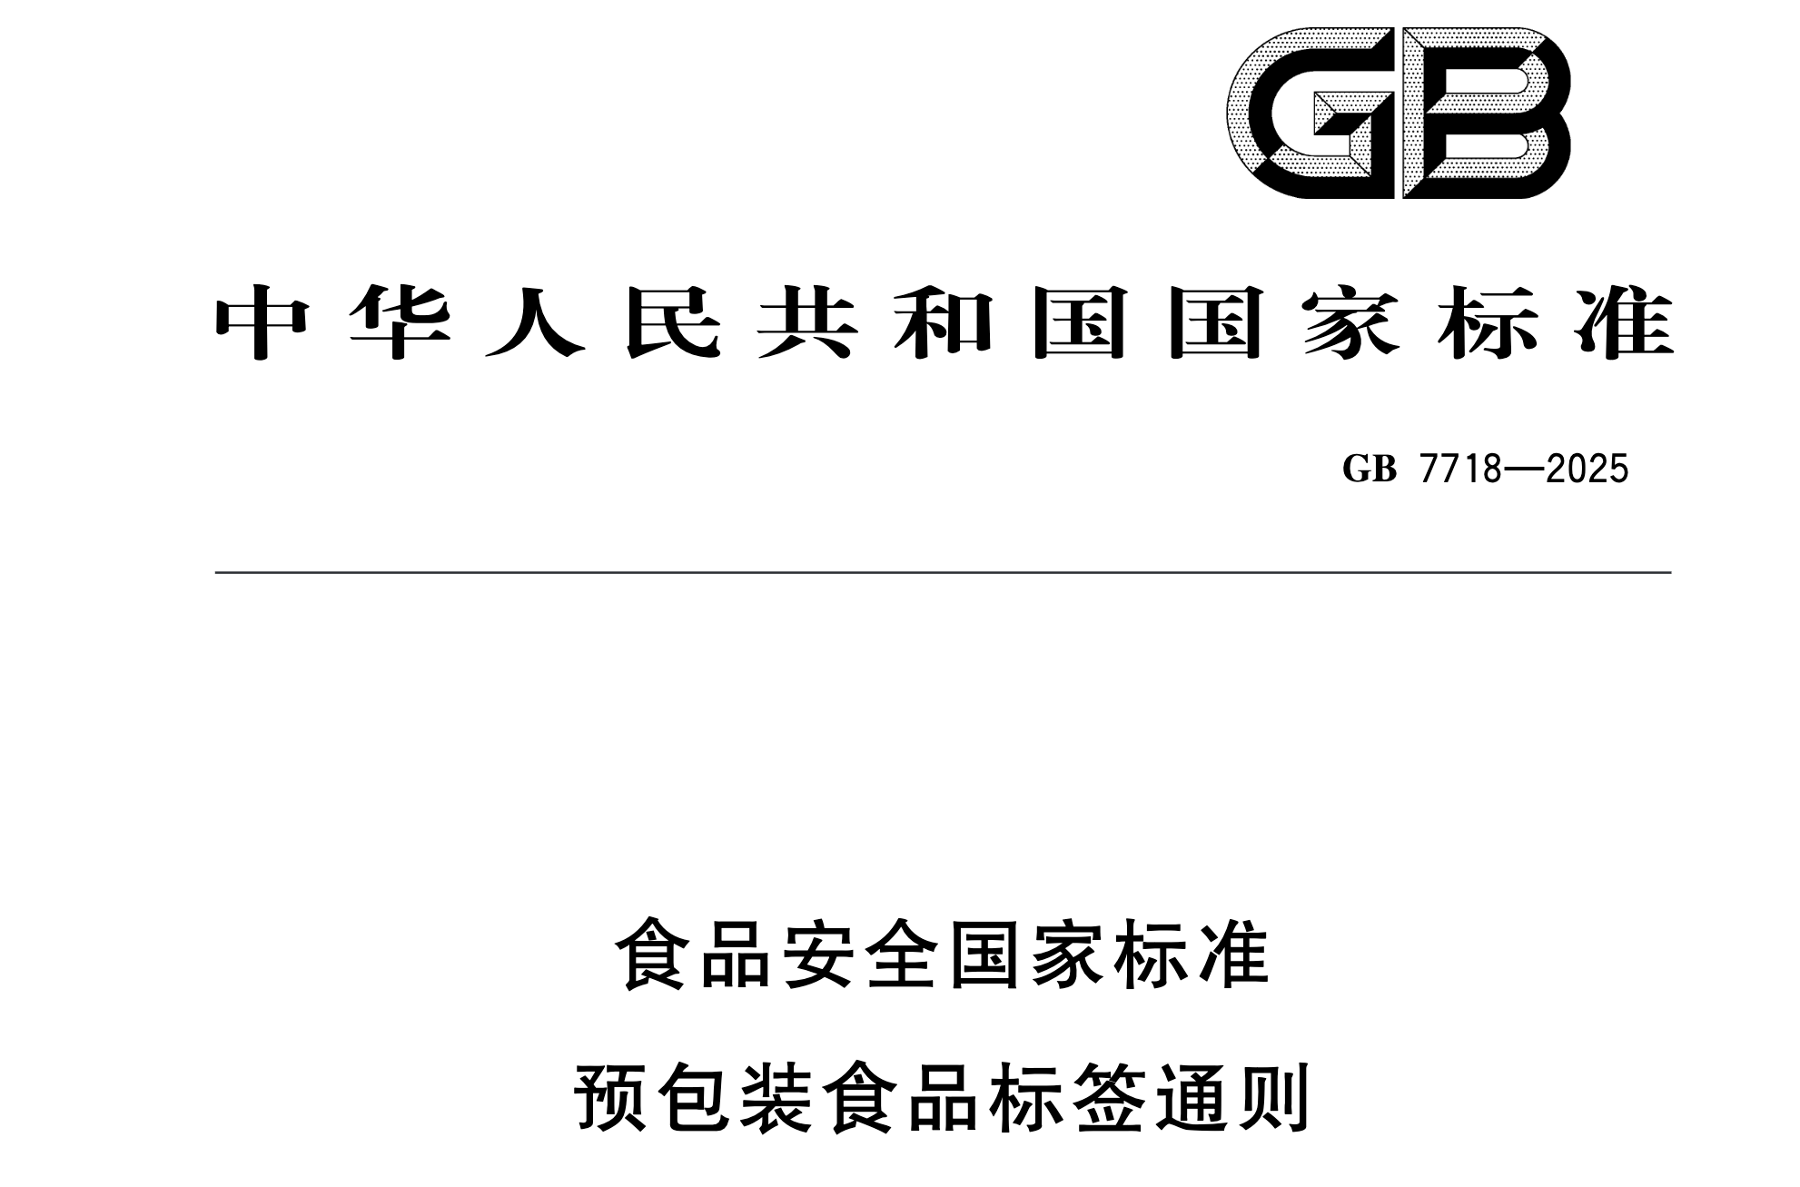
Food Allergens
Data collection
2020-2025: Data from 4 cities were collected. Over 16,000 people involved.
The food allergens in these individuals included Shrimp, Soybean, Crab, Milk, Eggs, etc.
Standard published
National Food Safety Standard “General Requirements for Prepackaged Food Labeling” was published, which stipulates that the eight major types of Allergens must be compulsorily declared on the label of prepackaged foods.
Notes:
In recent years, there has been a growing awareness and focus on food allergens in China, as part of a broader effort to ensure food safety and protect public health. Understanding food allergens and their effects on consumers has become increasingly important in order to better assess the situation of food allergens in the Chinese population. To address this, CFSA has conducted a surveillance study.
From 2020 to 2025, a study was conducted in four cities in Jiangxi Province, involving over 16,000 participants. This study identified common food allergens among individuals, including shrimp, crab, mango, milk, and eggs. This large-scale data collection enhances our understanding of the prevalence and impact of food allergens, providing valuable insights for developing more effective prevention and management strategies.
In response to these concerns, the GB 7718-2025 Food Safety National Standard was published. This standard outlines the General Rules for Prepackaged Food Labeling and mandates the compulsory declaration of the eight major allergens on the labels of prepackaged foods. This is a significant step in increasing consumer awareness and strengthening food safety regulations across the country.

Slide 18
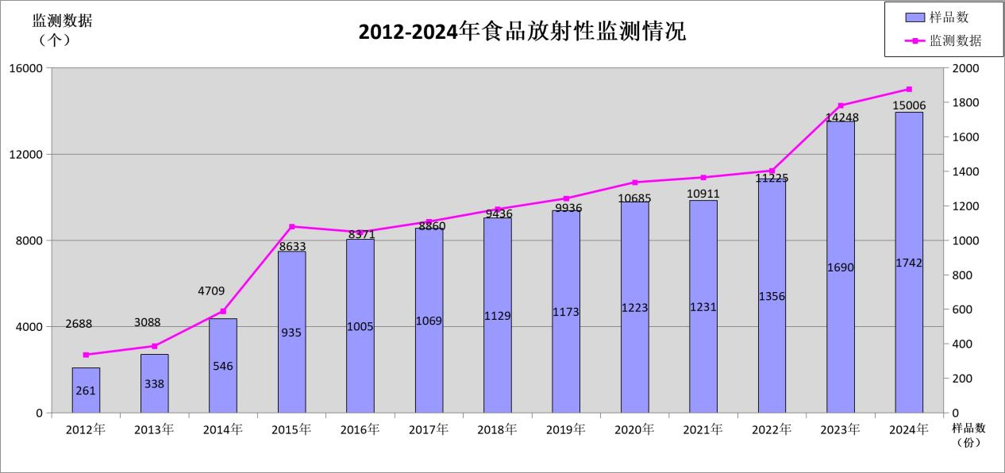
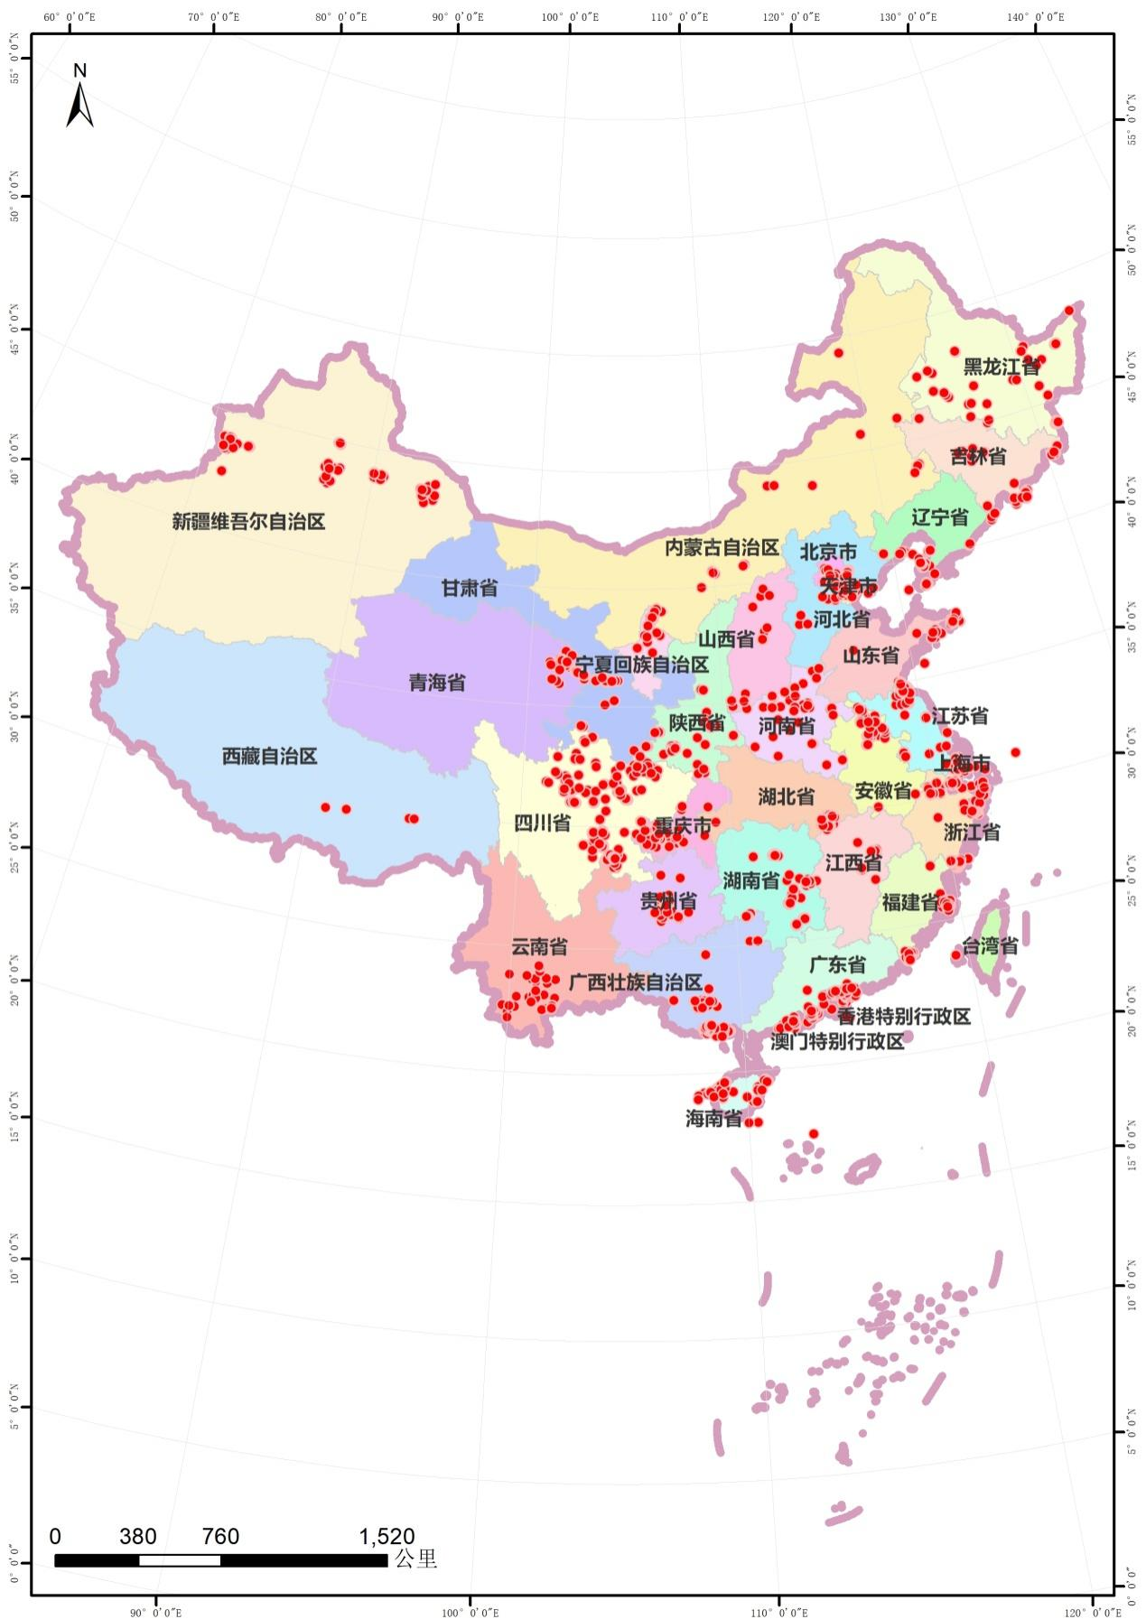
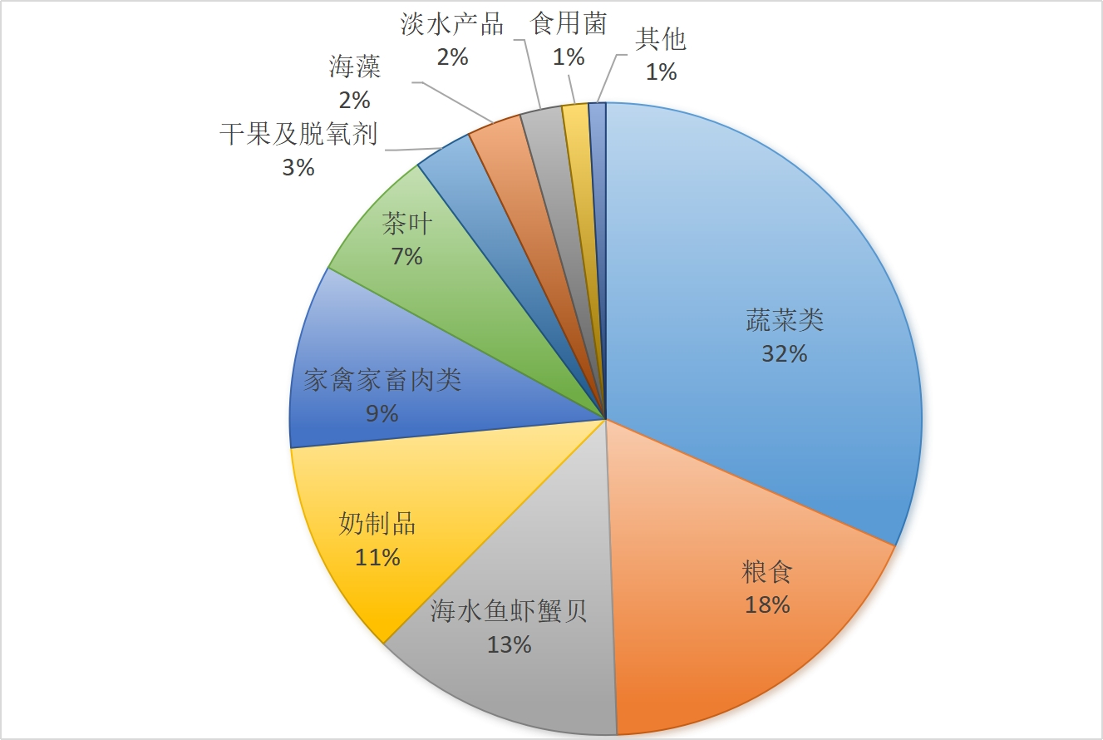
Radioactive Substances
Data collection
From 2012 to 2024, a total of 13,698 samples were monitored, and 117,796 data collection points were established across China.
The types of food include beverages, seafood, dried fruits and nuts, fruit juice, dairy products, aquatic food products, processed food, and others.
Suggestions to the government
We suggest that food safety authorities initiate research projects to assess the radioactive health risks of seafood, improve monitoring and data support, and enhance risk assessment capabilities for future nuclear accidents.
Notes:
Currently, incidents of nuclear contamination have raised public concern regarding radioactive substances in food. As a result, the public has become increasingly aware of the potential risks posed by radioactive materials in their daily food consumption. In response to these concerns, CFSA has carried out surveillance activities to monitor the presence of radioactive substances in food.From 2012 to 2024, a total of 13,698 samples were monitored across 117,796 data collection points established nationwide in China. This extensive data collection effort provides valuable insights into the prevalence of radioactive substances in food products throughout the country.To address the risks of radioactive contamination in food, we suggest that food safety authorities initiate research projects aimed at assessing the radioactive health risks of seafood, improving monitoring and data support, and enhancing the risk assessment capabilities for managing potential future nuclear accidents. These efforts are crucial to ensure that appropriate safety measures are in place and to maintain public trust in food safety standards. The types of food monitored included a wide range of products, such as beverages, seafood, dried fruits and nuts, fruit juices, dairy products, aquatic food products, processed foods, and others. This broad scope ensures that all major food categories are being thoroughly assessed for radioactive contamination.

Slide 19
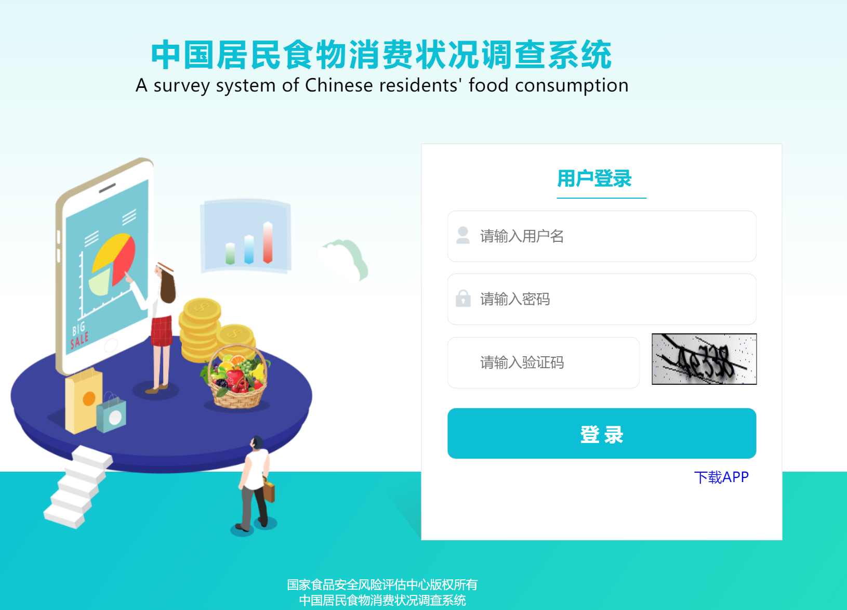
Nutrition
Consumption survey
A survey system of Chinese residents’ food consumption was developed
Carried in 31 provinces including 500 survey sites.
Food consumption survey was conducted on various foods, including infant food, the food and medicine continuum, processed foods with added sugars, prepackaged foods and others.
Over 20 million data were collected.
Notes:
CFSA is also deeply involved in addressing the nutritional health of the entire population,
To monitor the dietary habits of the population, CFSA developed a survey system of Chinese residents’ food consumption. This system was implemented across 31 provinces, including 500 survey sites nationwide. It provides a comprehensive understanding of food consumption patterns across China.
The food consumption survey covered a broad range of foods, including infant food, the food and medicine continuum, processed foods with added sugars, prepackaged foods, and others. This wide range of food types ensures that all aspects of the population's diet are accurately captured and assessed.
In total, over 20 million data points were collected. This large volume of data provides valuable insights into the dietary habits of Chinese residents and allows for more informed decisions to improve public nutrition and health policies

Slide 20
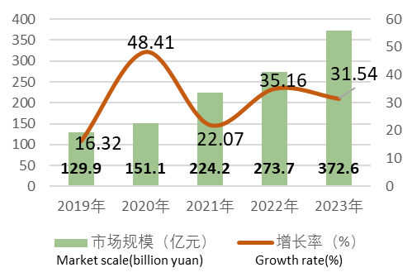
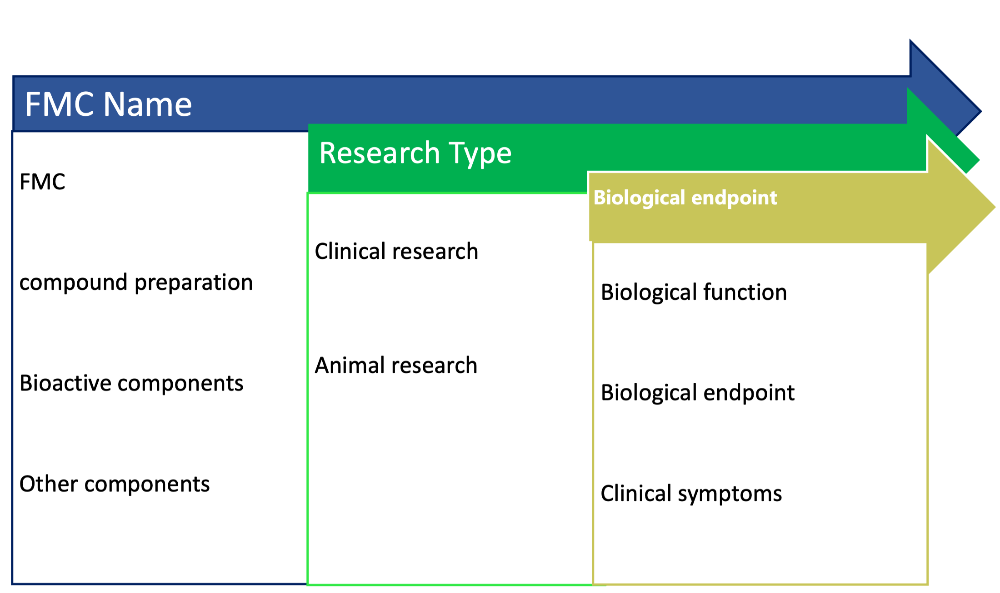
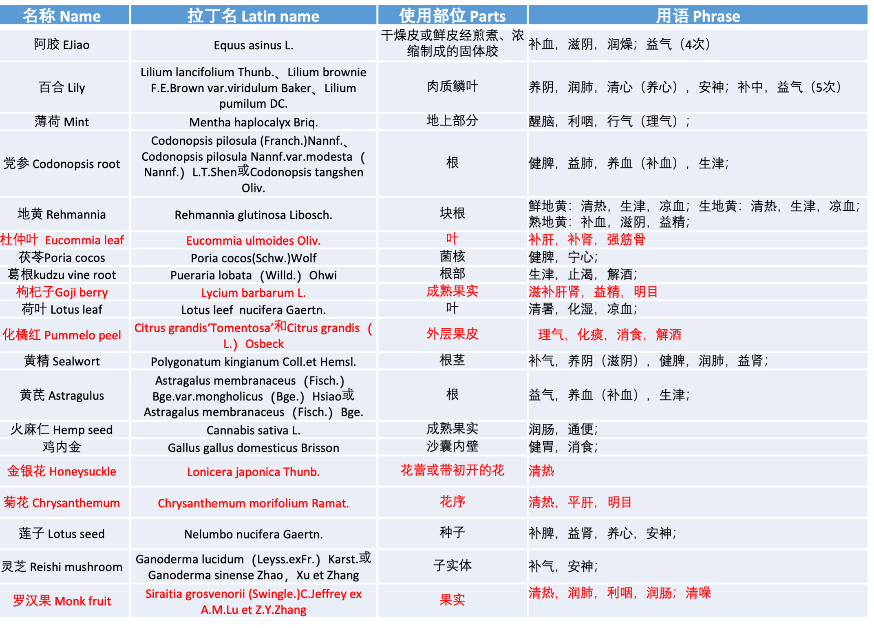
Nutrition
Food used as Chinese Tradational Medicine
A consumption survey was conducted across 30 provinces, investigating over 200 food and medicine continuum.
As part of this effort, risk assessments were carried out for 13 substances.
Health Claim Development:
One key aspect of our ongoing work is exploring the efficacy of these substances, identifying their potential health benefits.
Based on evidence-based medical research, we are also developing health claims to ensure that these substances are properly validated and safe for public consumption.
Notes:
The rapid and sustained growth of the market for food and medicine continuum has highlighted the need for more comprehensive research and regulatory measures to ensure safety and efficacy in both food and medicinal applications.
From 2019 to 2024, CFSA conducted a comprehensive consumption survey across more than 30 provinces, investigating over 200 food and medicine continuum substances. This survey plays a crucial role in understanding the intersection of food and medicinal products in the Chinese context.
As part of this effort, 106 substances were included in the food and medicine continuum list, as outlined in the regulation published in 2021. This reflects our commitment to staying updated with emerging trends and ensuring safety at the intersection of food and medicine.
Additionally, 13 newly added substances underwent food safety risk assessments, with reports submitted and subsequently approved, ensuring their safety for public consumption.
One of the key aspects of our ongoing work is to explore the efficacy of food and medicine continuum substances. We are focused on identifying their potential health benefits through rigorous research. This enables us to determine which substances may have therapeutic effects or contribute to overall well-being.
In addition, we are developing health claims based on evidence-based medical research. This ensures that any claims made about these substances are scientifically validated and meet the necessary safety standards for public consumption. Our goal is to provide clear, reliable information to consumers, supporting healthier food choices.

Slide 21
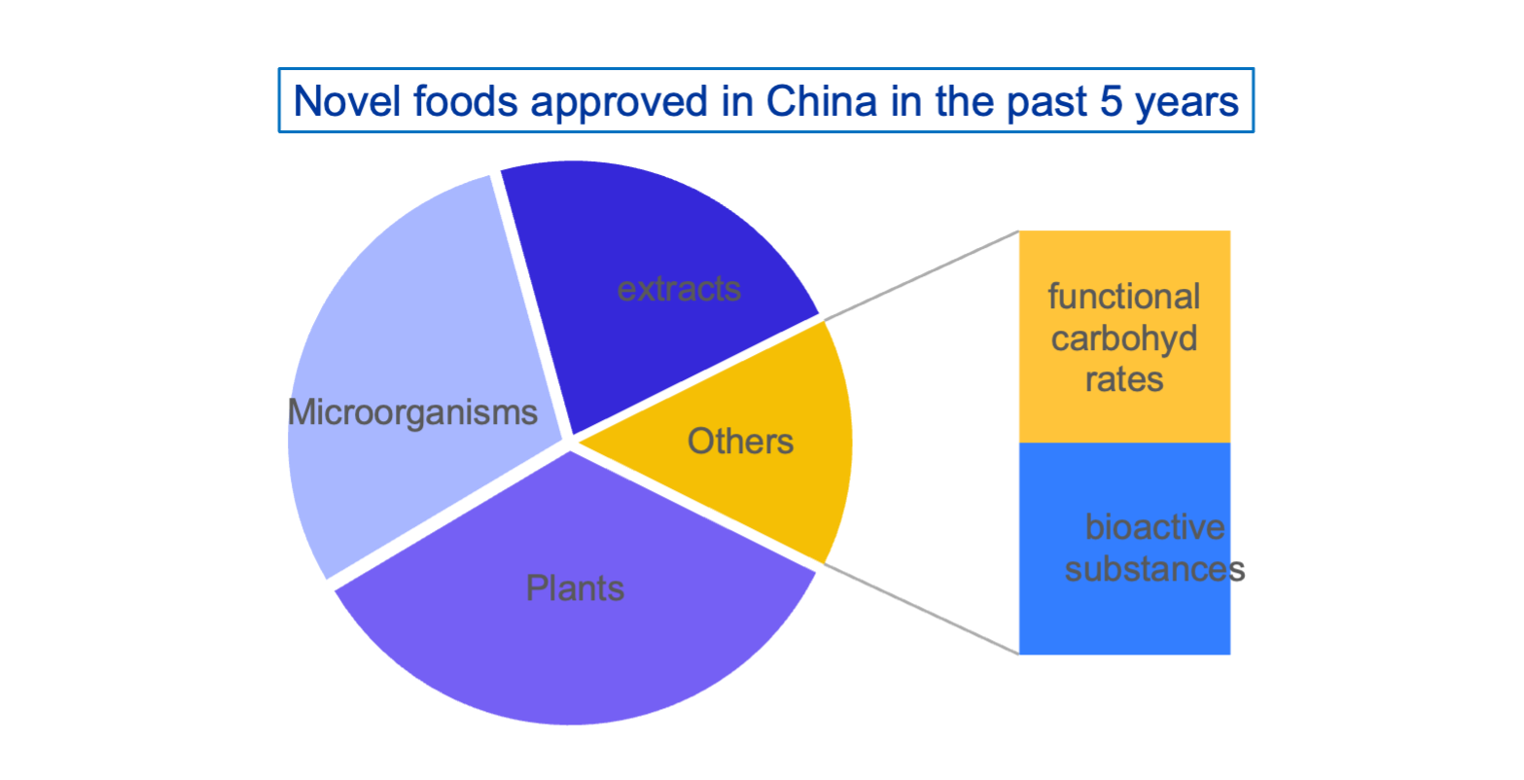
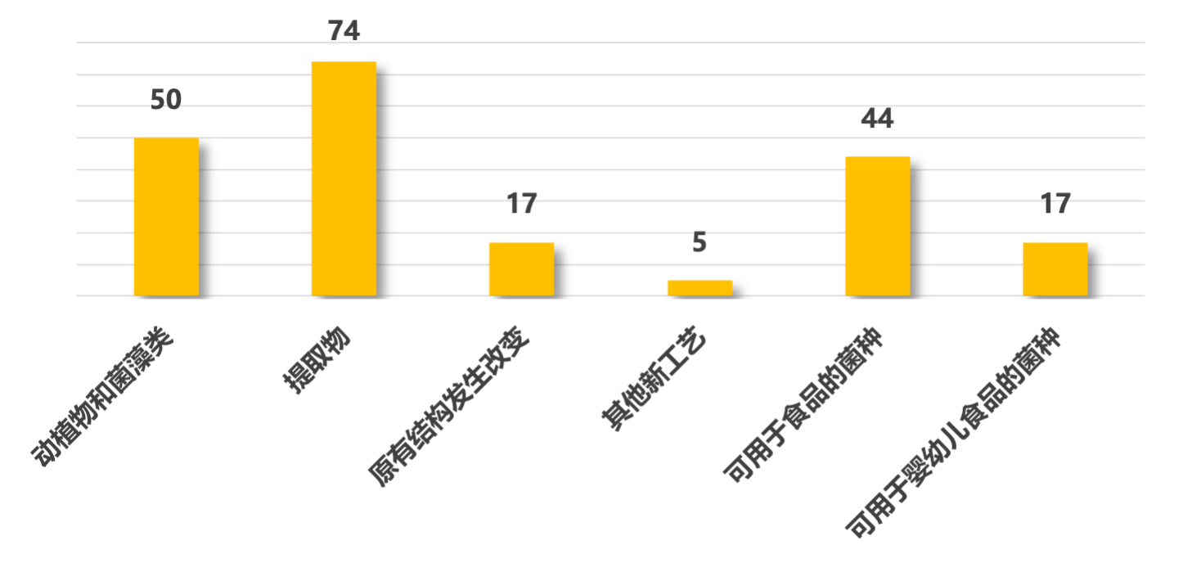
Premarket approval
Novel foods, new food additives, and new food contacts
Reviewed＞3000 applications, approved＞700 such products since 2016.
Guidelines for the Safety Review of Novel Food Ingredients from Cell Culture was pulished.
The Requirements for Application Materials for the Safety Evaluation of Genetically Modified Microorganisms Used in Food Processing (Trial) was issued.
Scientific Opinions and Regulatory Recommendations on Cultivated Meat was submitted to the food safety authority.
“Study on the Safety Assessment and Guarantee System for the Development of Alternative Protein Industry in China” was published.
Notes:
With the development of technology, novel foods, new food additives, and new food-related products have gradually entered the public's awareness. To ensure food safety, CFSA has also conducted relevant research in these areas.
Since 2016, CFSA has reviewed over 3,000 applications and approved more than 700 products in the fields of novel foods, new food additives, and new food-related products. This demonstrates our commitment to staying up-to-date with innovations in the food industry while ensuring their safety for consumers.
As part of these efforts, the Guidelines for the Safety Review of Novel Food Ingredients from Cell Culture were published, establishing a framework for evaluating the safety of emerging ingredients. Additionally, the Requirements for Application Materials for the Safety Evaluation of Genetically Modified Microorganisms Used in Food Processing (Trial) were issued, standardizing the evaluation process for genetically modified microorganisms used in food production.
CFSA also submitted scientific opinions and regulatory recommendations on cultivated meat to the food safety authority, showcasing our proactive approach to evaluating new food technologies. Furthermore, the 'Study on the Safety Assessment and Guarantee System for the Development of Alternative Protein Industry in China' was published to guide the growth of this sector while ensuring public health and safety.

Slide 22





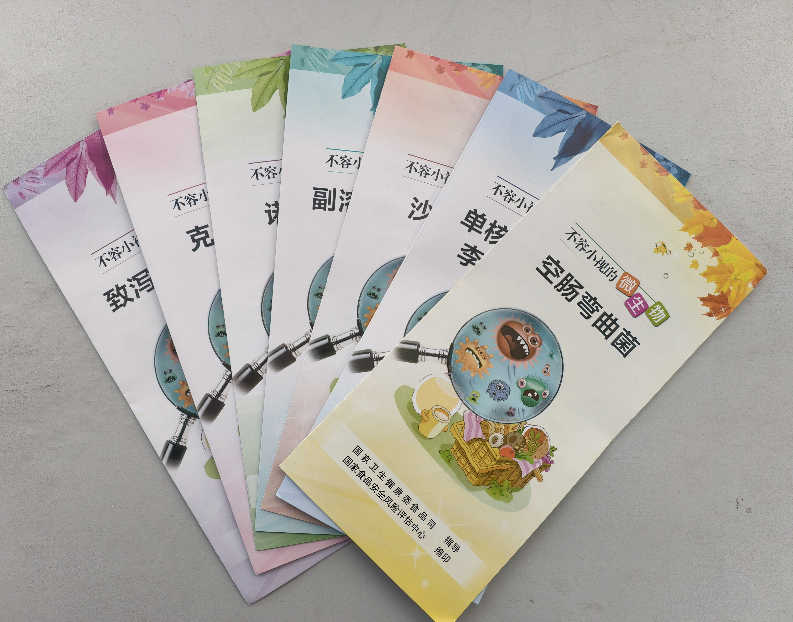
Risk Communication
Multi-channel risk communication strategies
TV Shows
Social Media
Mobile App
Printed Materials
Notes:
For risk communication, we utilize various channels to engage with the public. We collaborate with Chinese TV channels to present information on food safety and nutrition. And, we have our own WeChat account (a popular social app in China, similar to WhatsApp), where our professional team creates short videos to share information with the public. In addition, we developed a mini-game, where players can learn knowledge through gameplay.
We also continue to use traditional methods of communication, such as printed materials like books and leaflets.
By employing multi-channel risk communication, we enhance the efficiency of public engagement, ensuring that information reaches diverse audiences through TV, social media, and printed materials. This approach increases transparency, builds trust, and enables the timely, accurate dissemination of information, especially in times of crisis. It also meets various informational needs and encourages public participation, ultimately improving risk management and supporting compliance with safety regulations.

Slide 23
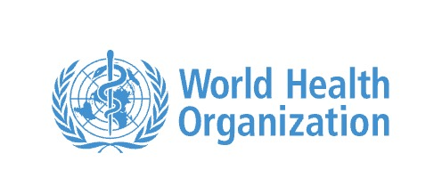
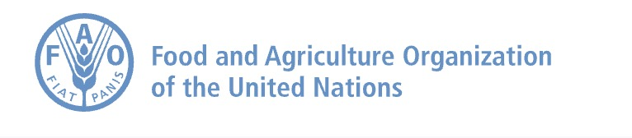

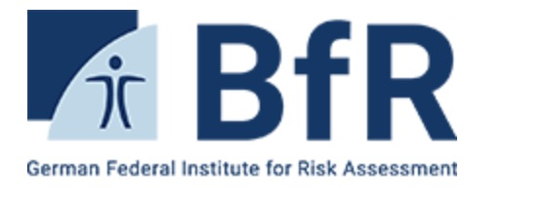
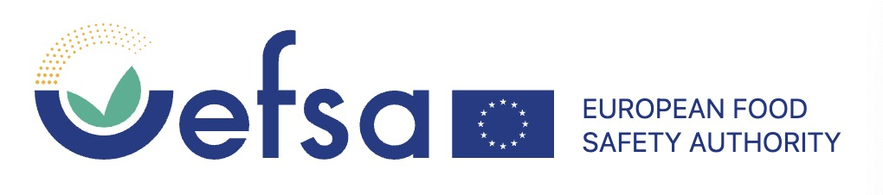


CFSA‘s Role Globally
Cooperated with international organizations
Notes:
CFSA has collaborated with numerous international organizations, including the WHO, FAO, Codex Alimentarius, the European Food Safety Authority (EFSA), the U.S. Food and Drug Administration (FDA), and the German Federal Institute for Risk Assessment (BfR). We have 25 experts of JECFA, JEMRA, JMPR; In 2024, our colleague, Dr. Tian Jing, was elected Vice Chair of the Codex Alimentarius Commission (CAC).

Slide 24
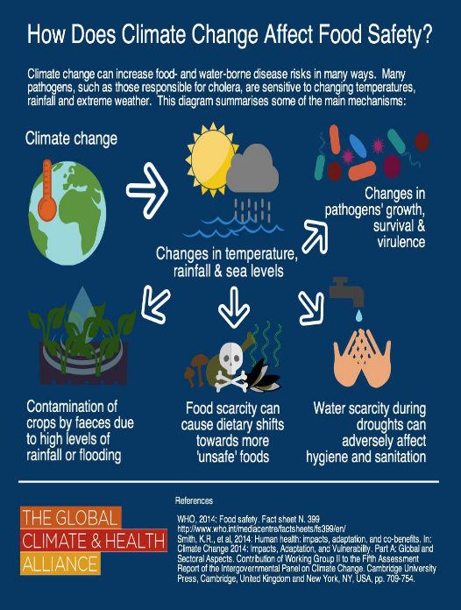
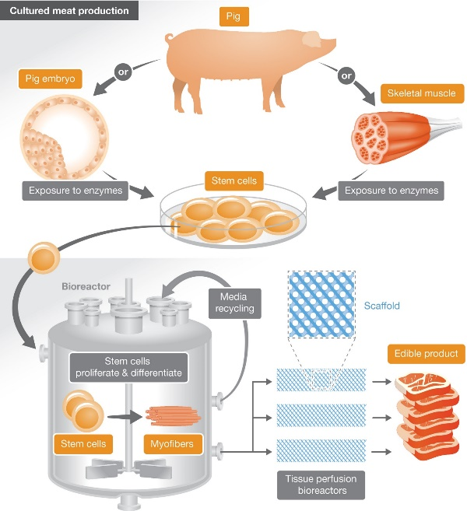
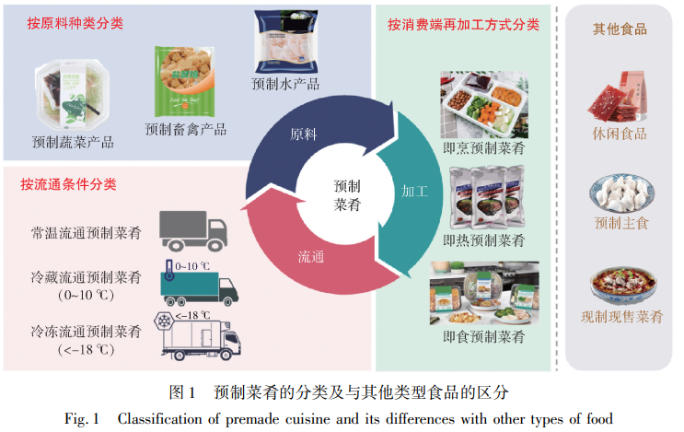
Scientific Challenges
Social Challenges
Antibiotic resistance
NFPS (insects, cell-based, food-medicine substances)
New processing technologies (nanotechnology, 3D printing, cellular engineering)
New understandings of traditional risks (chemical contamination, allergies)
Changes in pollution patterns due to climate change
Internet+ new business models
Lifestyle changes
Impact of globalization
Professional whistleblowing
Regulatory approaches
Notes:
Looking ahead, there are several key areas of focus for the future of food safety.
First, in terms of Challenges, we face emerging risks such as new foodborne pathogens and increasing complexities in global supply chains. However, these challenges also present opportunities for innovation, particularly in traceability and advancements in food safety technologies.
Second, regarding Innovation and Progress, we see significant advancements in food safety testing, risk assessment, and detection methods. Technologies like biotechnology, nanotechnology, and data analytics will play an increasingly important role in improving food safety practices.
Next, Policy and Regulation will continue to evolve. Future food safety policies will need to align internationally, with a focus on stricter regulations and stronger governmental enforcement to ensure safety across borders.
Globalization and Collaboration is another critical aspect, as global trade and supply chains will continue to impact food safety. There will be a growing need for international cooperation to address challenges and improve food safety systems worldwide.
Lastly, Sustainability and Social Responsibility will play a major role in food safety. Aligning food safety with sustainability goals and enhancing transparency will help raise consumer awareness and ensure that food safety practices contribute to broader societal well-being.
In conclusion, the future of food safety will rely on continued innovation, global collaboration, and a stronger commitment to sustainability.

Slide 25
Thanks for your attention!
fanyongxiang@cfsa.net.cn
www.cfsa.net.cn

